Slide 1

SELECTING THE BEST NEIGHBORHOOD TO LIVE IN NEW YORK
By Thahseen AG

Slide 2
SELECTING THE BEST NEIGHBORHOOD TO LIVE IN NEW YORK
The objective is to select a neighborhood in New York with a low crime rate and having the amenities like Grocery Store, Restaurant, Gym, Pharmacy nearby.
The selection is done by:
Categorizing Neighborhoods according to the crime reported.
Scoring Neighborhoods based on the amenities they have.

Slide 3
Data Sources
The crime reported in each borough obtained from NYPD Open Data which includes details like offence description,Victim Age and sex, Borough name and latitude and laitude of where the crime has been reported.
A Borough to Neighborhood mapping data set along with the Latitude and Longitude of each Neighborhood, from https://cocl.us/new_york_dataset
Foursquare API to get all the venues nearby given the latitude and longitude.

Slide 4
DATA WRANGLING
Only the below details from NYPD crime reported is used in this project.
Column Name | Renamed Column Name | Description
BORO_NM | Borough | The name of the borough in which the incident occurred
CMPLNT_FR_DT | Date | Exact date of occurrence for the reported event (or starting date of occurrence, if CMPLNT_TO_DT exists)
OFNS_DESC | Offence | Description of offense corresponding with key code
Latitude | Latitude | Midblock Latitude coordinate for Global Coordinate System, WGS 1984, decimal degrees (EPSG 4326)
Longitude | Longitude | Midblock Longitude coordinate for Global Coordinate System, WGS 1984, decimal degrees (EPSG 4326)

Slide 5
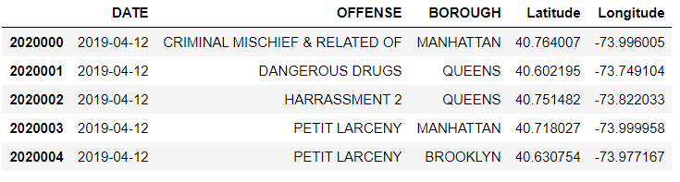
NYPD Crime Data Set
The resulting data set has 1000 samples with 5 features to the data.

Slide 6
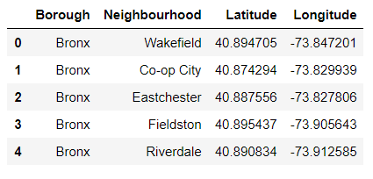
Borough to Neighborhood Data Set

Slide 7
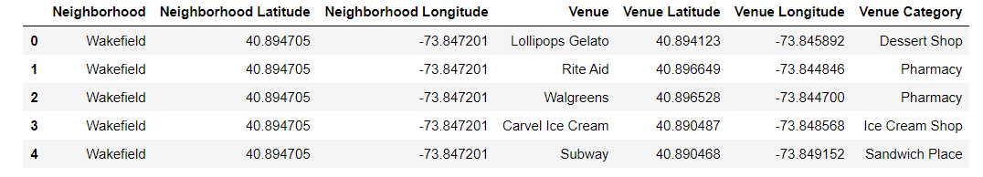
FourSquare API for Venues in Neighborhoods

Slide 8
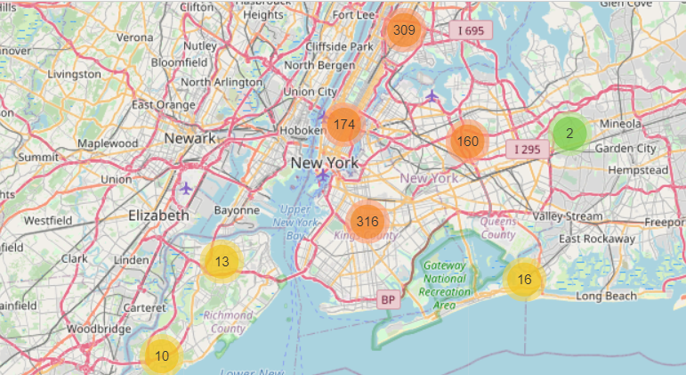
New York Map with Crime Clusters

Slide 9
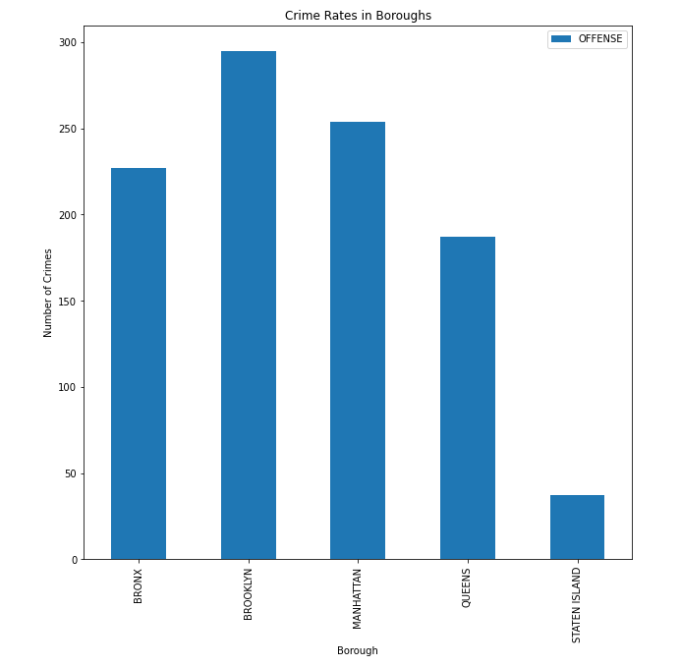
Borough Crime Rates

Slide 10
Neighborhood Crime Rate
The Data obtained from the NYPD has to be combined with the Borough to Neighborhood to know which neighborhood the crime has occured.
This achieved using the crime latitude and longitude and then finding the nearest neighborhood to it based on the neighborhoods latitude and Longitude.
This is achieved using Haversine Formula.

Slide 11

Haversine Formula
Determines the great-circle distance between two points on a sphere given their longitudes and latitudes.
where,
φ1, φ2 are the latitude of point 1 and latitude of point 2 (in radians),
λ1, λ2 are the longitude of point 1 and longitude of point 2 (in radians).
d is the distance between the two points along a great circle of the sphere (see spherical distance),
r is the radius of the sphere.

Slide 12
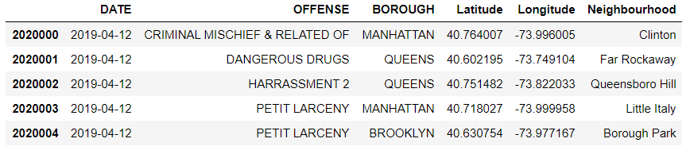
Neighborhood Crime Data

Slide 13
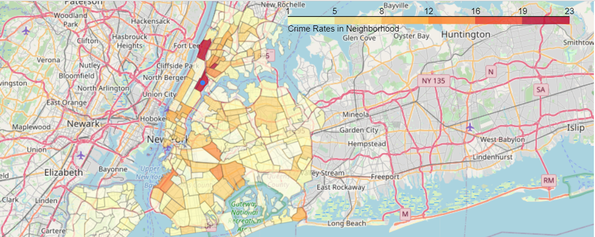
Neighborhood Crime Data

Slide 14
Selecting The Desired Amenities
For better categorization the Venue Category given as eg: Asian Restaurant or Indian Restaurant are renamed to just ‘Restaurants’.
The desired neighborhood is selected on the basis of different ‘amenities’ or required venues nearby.
To ‘score’ each location based on the amenities/venues nearby a scoring mechanism is used,Weighted Average.

Slide 15
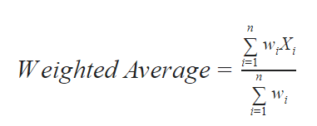
Weighted Average
Calculation that takes into account the varying degrees of importance of the numbers in a data set.
Amenities Score,
Amenities | Score
Grocery Store | 3
Restaurant | 3
Gym | 2
Pharmacy | 2

Slide 16
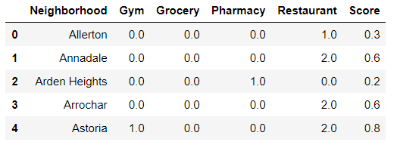
Neighborhoods Venues
Each categories is grouped with only the desired amenities and is then scored with a weighted average score to determine desirability of the neighborhood.

Slide 17
KMeans Cluster
KMeans takes data points as inputs and groups them into k clusters, which is non overlapping.
The less variation we have within clusters, the more homogeneous/similar the data points are in the cluster.
We have used the KMeans clustering algorithm to find a neighborhood with the least amount of crimes and desired amenities/venues

Slide 18
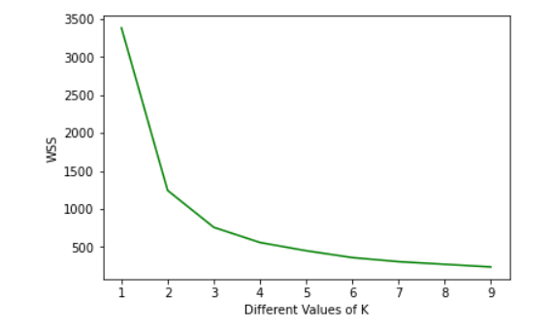
Selecting Best K-Elbow Method/WSS
The Squared Error for each point is the square of the distance of the point from its predicted cluster center.WSS is the sum of all the Square Error for each cluster.

Slide 19
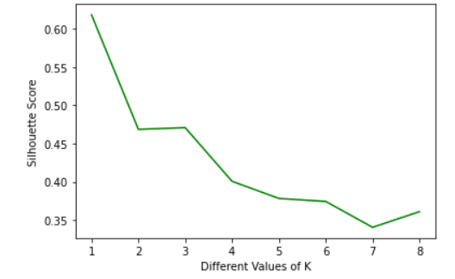
Selecting Best Value for K-Silhouette Method
The silhouette value measures how similar a point is to its own cluster compared to other clusters. The value ranges between +1 and -1.

Slide 20
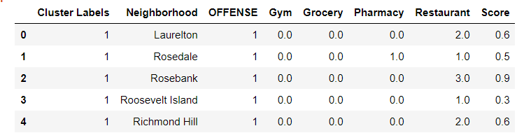
KMeans Model
From both the method it is clear that the best value for k is 3.
Fitting the data with k = ‘3’ gives us 3 clusters having similar characteristics.

Slide 21
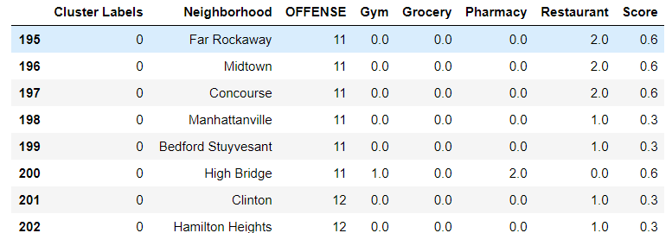
Cluster 0
High Number of Crimes.

Slide 22
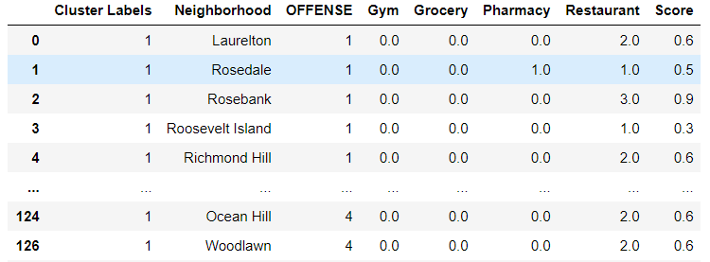
Cluster 1
Less Number of Crimes.

Slide 23
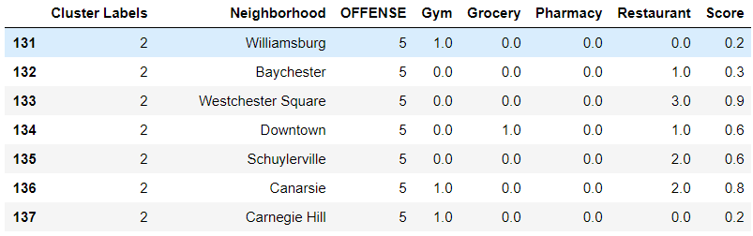
Cluster 2
Moderate Number of Crimes.

Slide 24
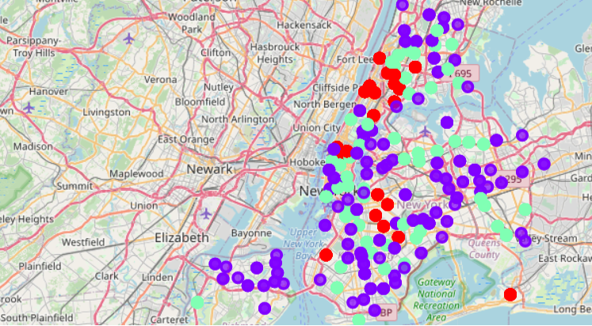
Cluster Map
Red-Cluster 0, Blue-Cluster 1, Green-Cluster 2

Slide 25
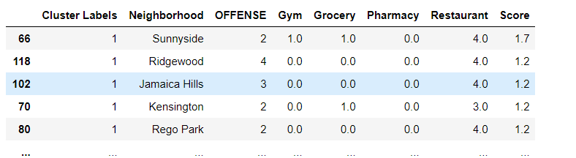
RESULT AND DISCUSSION
The careful examination of all the 3 clusters indicates that the Cluster 1 has neighborhoods with best amenities score and less amount of crime rate.

Slide 26
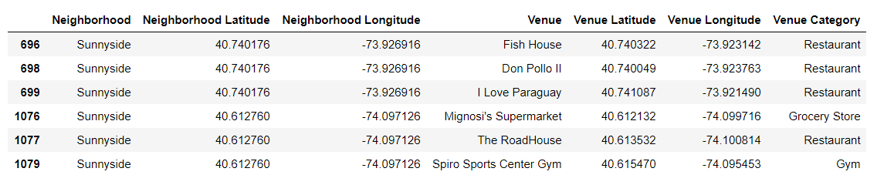
CONCLUSION
Based on the above I conclude that Sunnyside is the best neighborhood to live in with having only 2 offences reported in past one year and having a amenities score of 1.7.

Slide 27
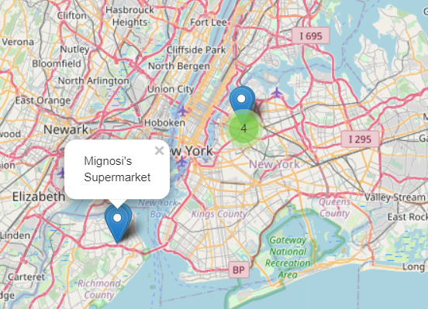
Sunnyside Neighborhood

